Slide 1
Lesson 07 Normal Distribution Concepts E214 – Statistical Methods for Engineering

Slide 2
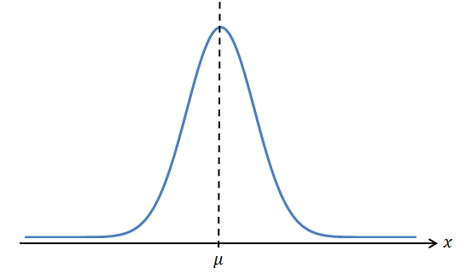
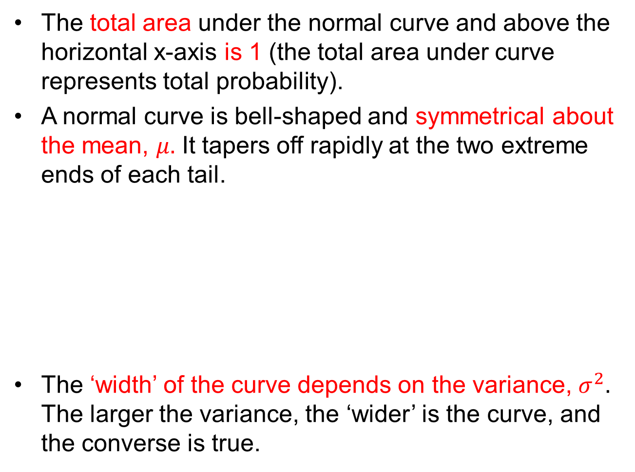
Properties of the Normal Distribution
The total area under the normal curve and above the horizontal x-axis is 1 (the total area under curve represents total probability).
A normal curve is bell-shaped and symmetrical about the mean, $μ.$ It tapers off rapidly at the two extreme ends of each tail.
The ‘width’ of the curve depends on the variance, $σ^{2}.$ The larger the variance, the ‘wider’ is the curve, and the converse is true.

Slide 3

Properties of Normal Distribution
For any normal distribution, mean=median=mode=$μ$.
The notation for a continuous random variable X which follows a normal distribution with mean $μ$ and variance $σ^{2}$ is $X\sim N\left(μ,σ^{2}\right).$

Slide 4
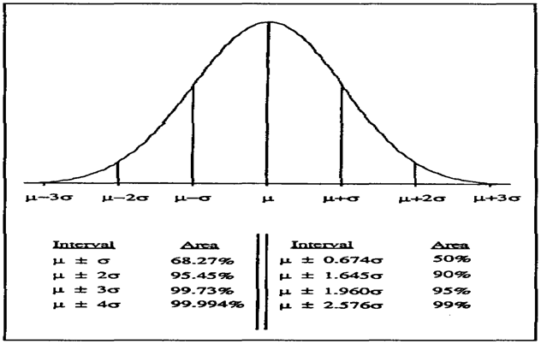
Areas under Normal Curve for Different Standard Deviations from the Mean

Slide 5
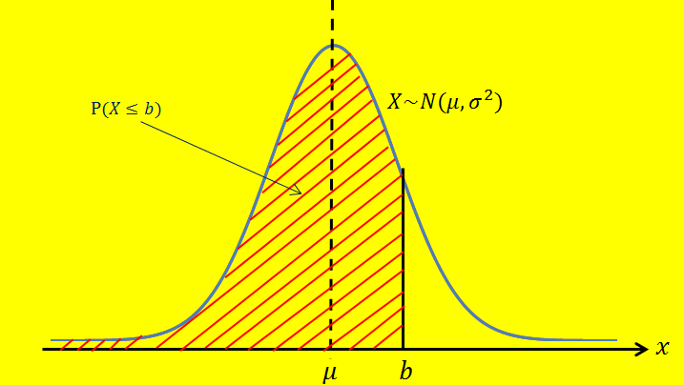
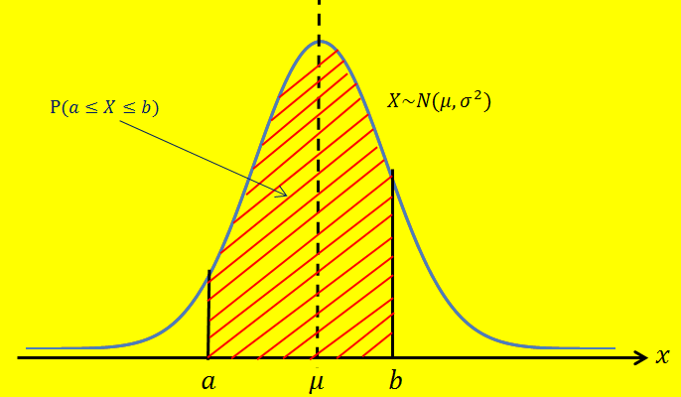
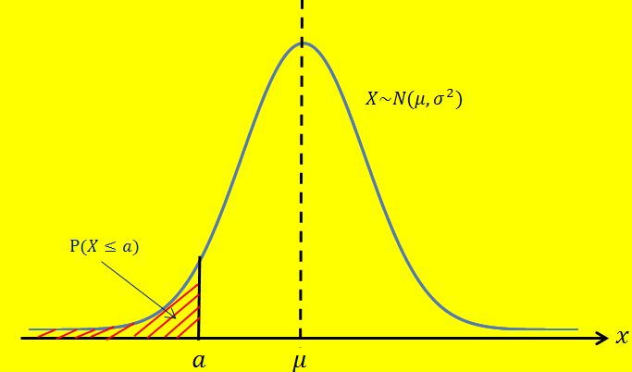

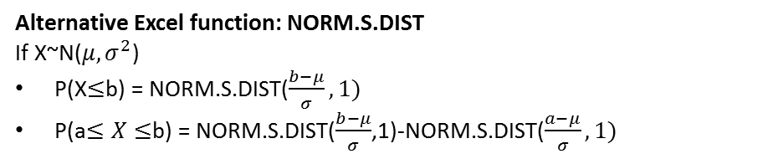
Calculating Probabilities using the Normal Distribution
Excel Functions:
$P\left(X≤b\right)=NORM.DIST\left(b, μ, σ, 1\right)$
$P\left(a≤X≤b\right)=NORM.DIST\left(b,μ,σ,1\right)−NORM.DIST(a,μ,σ,1)$
=
-
Alternative Excel function: NORM.S.DIST
If X~N($μ,σ^{2}$)
P(X$≤$b) = NORM.S.DIST($\frac{b−μ}{σ},1)$
P(a$≤X≤$b) = NORM.S.DIST($\frac{b−μ}{σ}$,1)-NORM.S.DIST($\frac{a−μ}{σ},1)$

Slide 6
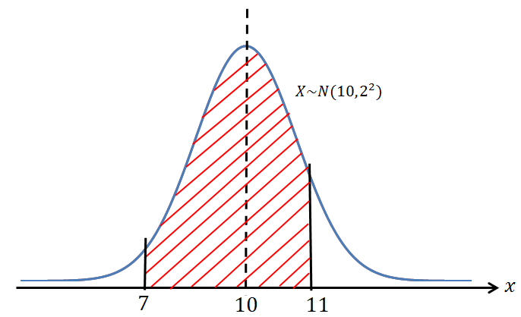
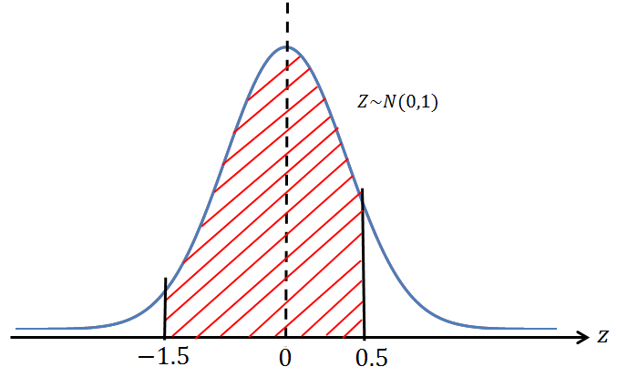
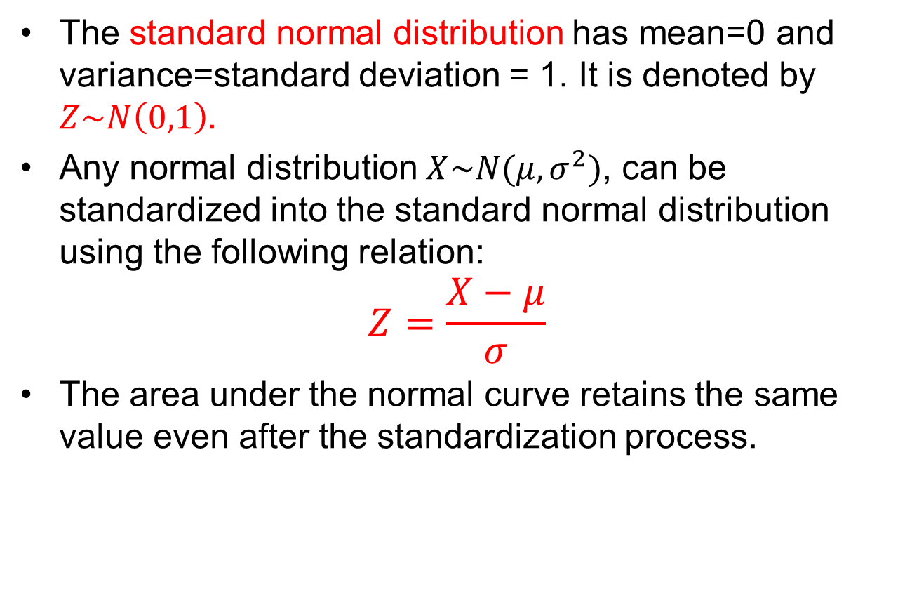
The Standard Normal Distribution
The standard normal distribution has mean=0 and variance=standard deviation = 1. It is denoted by $Z\sim N\left(0,1\right).$
Any normal distribution $X\sim N(μ,σ^{2})$, can be standardized into the standard normal distribution using the following relation:
$$Z=\frac{X−μ}{σ}$$
The area under the normal curve retains the same value even after the standardization process.
E.g.
Same area
Standardization from X to Z

Slide 7
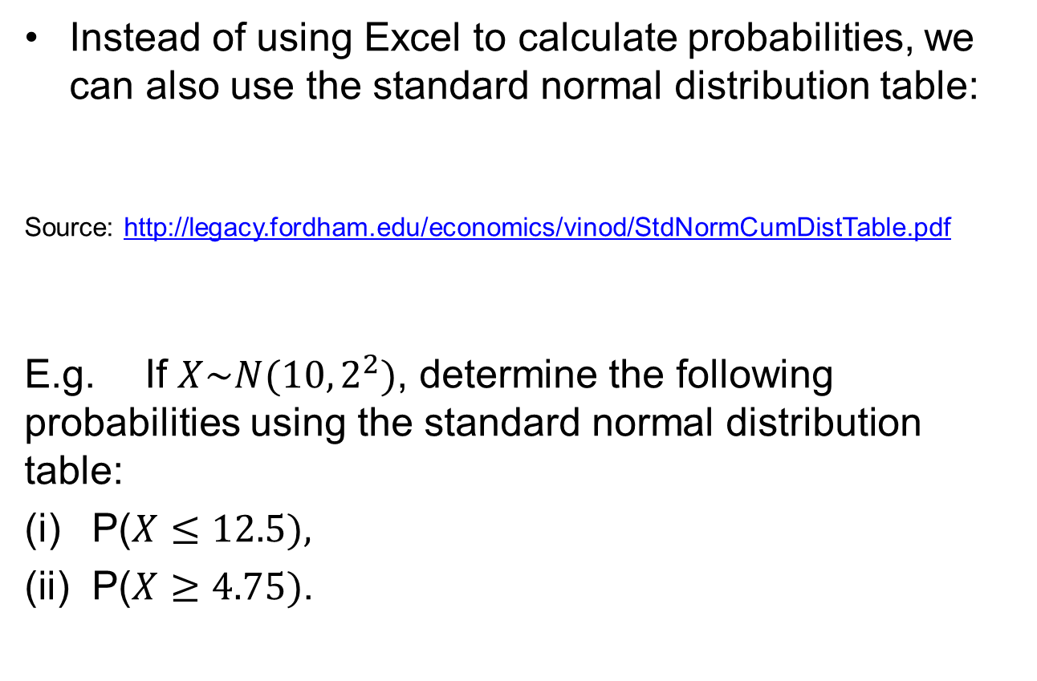
Using Standard Normal Distribution Tables to Calculate Probabilities
Instead of using Excel to calculate probabilities, we can also use the standard normal distribution table:
Source: http://legacy.fordham.edu/economics/vinod/StdNormCumDistTable.pdf
E.g. If $X\sim N(10,2^{2})$, determine the following probabilities using the standard normal distribution table:
P($X≤12.5),$
P($X≥4.75)$.

Slide 8
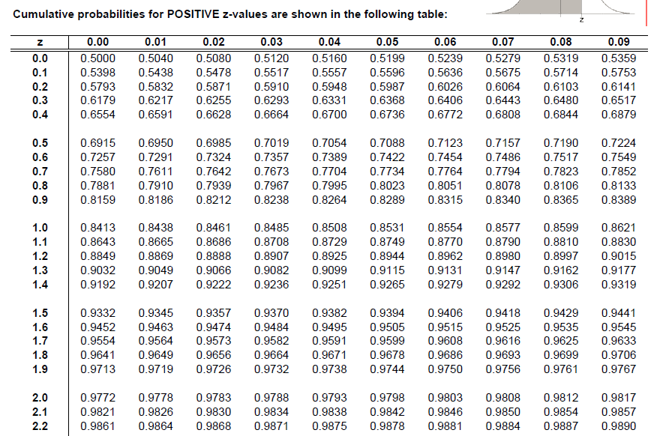

Using Standard Normal Distribution Tables to Calculate Probabilities
Solution:
P($X≤12.5)$
$=P(Z≤\frac{12.5−10}{2})$ [Standardize from X to Z first]
$=P(Z≤1.25)$
Since the value 1.25 is positive, refer to the table for positive z values:
On the leftmost column, look for value 1.2 first.
Then, under the row “1.2”, look for the column with value ‘0.05’,
since 1.2+0.05 = 1.25.
Answer is 0.8944.

Slide 9
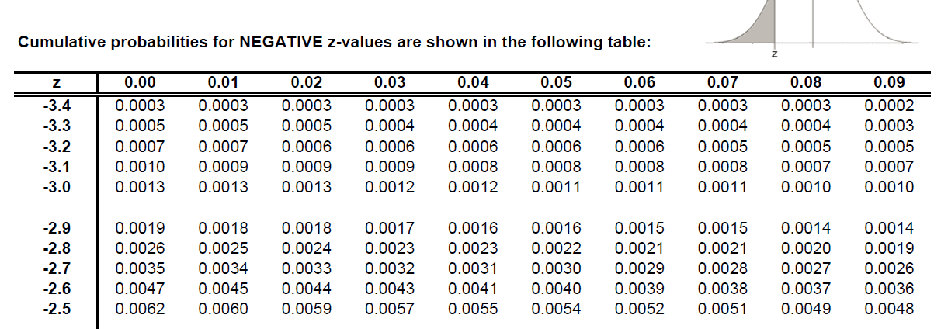



Using Standard Normal Distribution Tables to Calculate Probabilities
(ii) P($X≥4.75)$
= P($Z≥\frac{4.75−10}{2})$ [Standardize from X to Z first]
= P($Z≥−2.625)$
= 1 – P($Z<−2.625)$
= 1 – P($Z≤−2.625)$ [ Make sure inequality sign is ‘≤’]
[For continuous r.v., it doesn’t matter if we put in or remove the equal sign]
Since the value -2.625$≈−2.63$ is negative,
refer to the table for negative z values:
To find P(Z$≤−2.63):$
On the leftmost column, look for value -2.6 first.
Then, under the row ‘-2.6’, look for the column with value ‘0.03’,
since – [ 2.6+0.03] = -2.63.
P$\left(Z≤−2.63\right)=0.0043.$
Answer is
1-0.0043=0.9957 $∎$

Slide 10
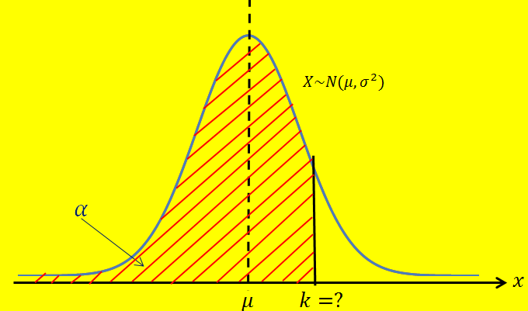
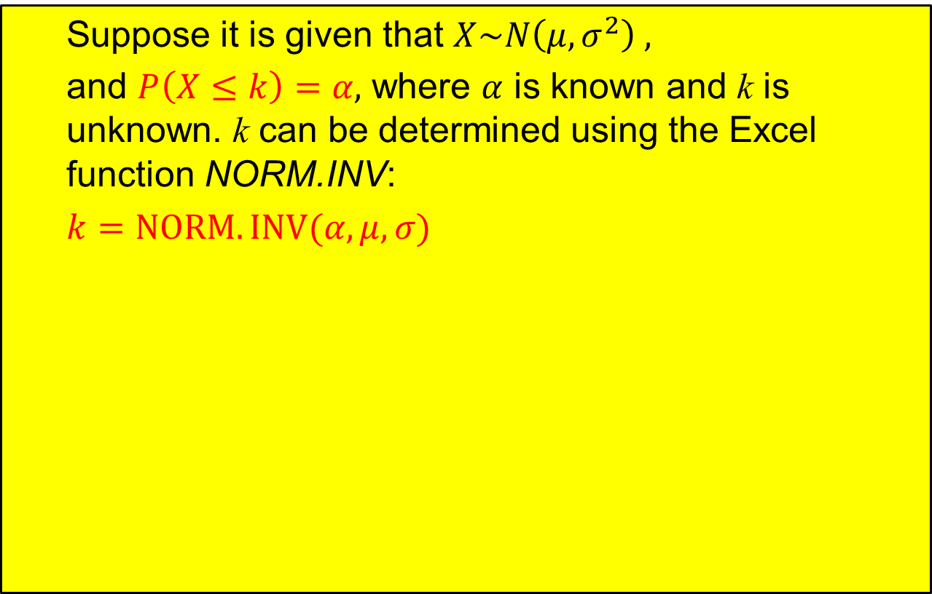
Calculating the Inverse of a Normal Distribution
Suppose it is given that $X\sim N\left(μ,σ^{2}\right) ,$
and $P\left(X≤k\right)=α,$ where $α$ is known and k is unknown. k can be determined using the Excel function NORM.INV:
$k=NORM.INV(α,μ,σ)$
Must be left-tail area!

Slide 11
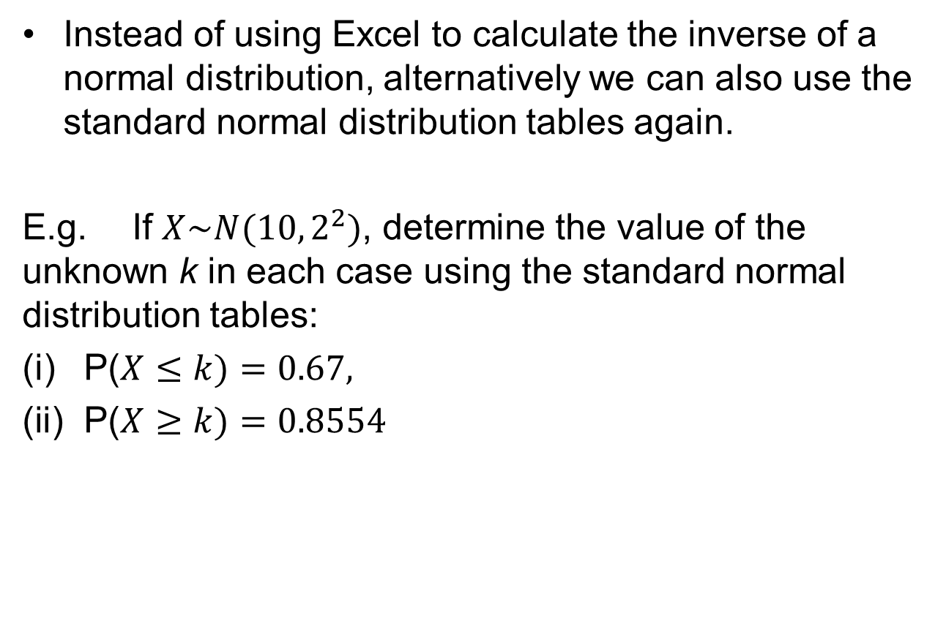
Using Standard Normal Distribution Tables to Calculate Inverse of Normal Distribution
Instead of using Excel to calculate the inverse of a normal distribution, alternatively we can also use the standard normal distribution tables again.
E.g. If $X\sim N(10,2^{2})$, determine the value of the unknown k in each case using the standard normal distribution tables:
P($X≤k)=0.67,$
P($X≥k)=0.8554$

Slide 12
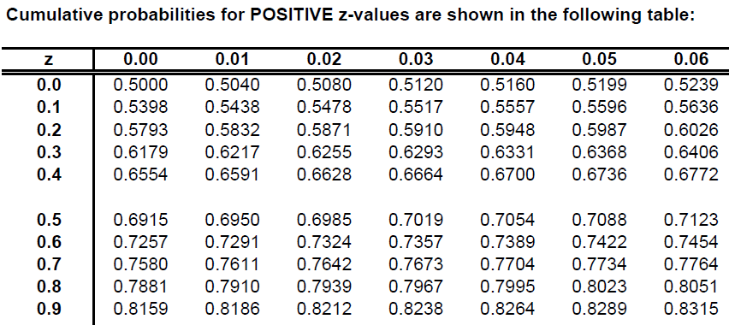
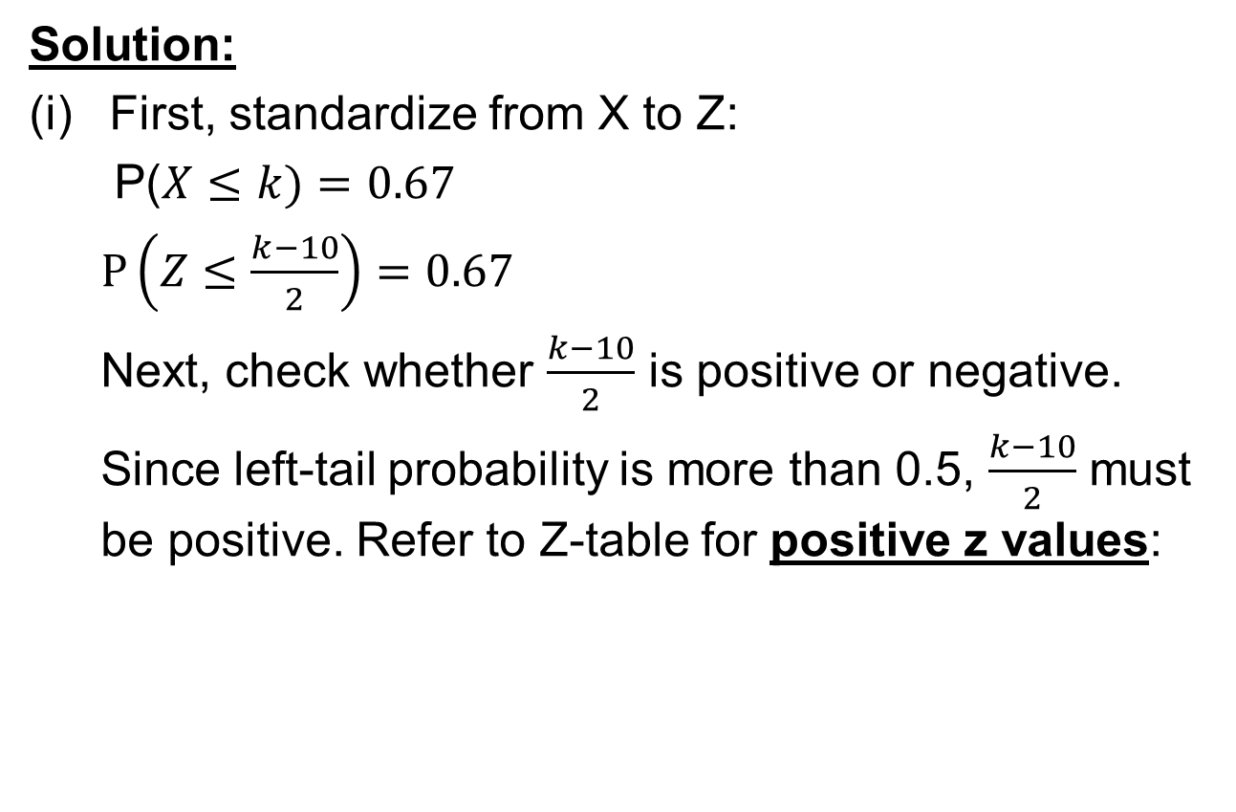

Using Standard Normal Distribution Tables to Calculate Inverse of Normal Distribution
Solution:
First, standardize from X to Z:
P($X≤k)=0.67$
$P\left(Z≤\frac{k−10}{2}\right)=0.67$
Next, check whether $\frac{k−10}{2}$ is positive or negative.
Since left-tail probability is more than 0.5, $\frac{k−10}{2}$ must be positive. Refer to Z-table for positive z values:
Check the probability value to see if we can find 0.67.
Working backwards, we can see that
$$\frac{k−10}{2}=0.4+0.04=0.44$$
$$k=10.88$$

Slide 13
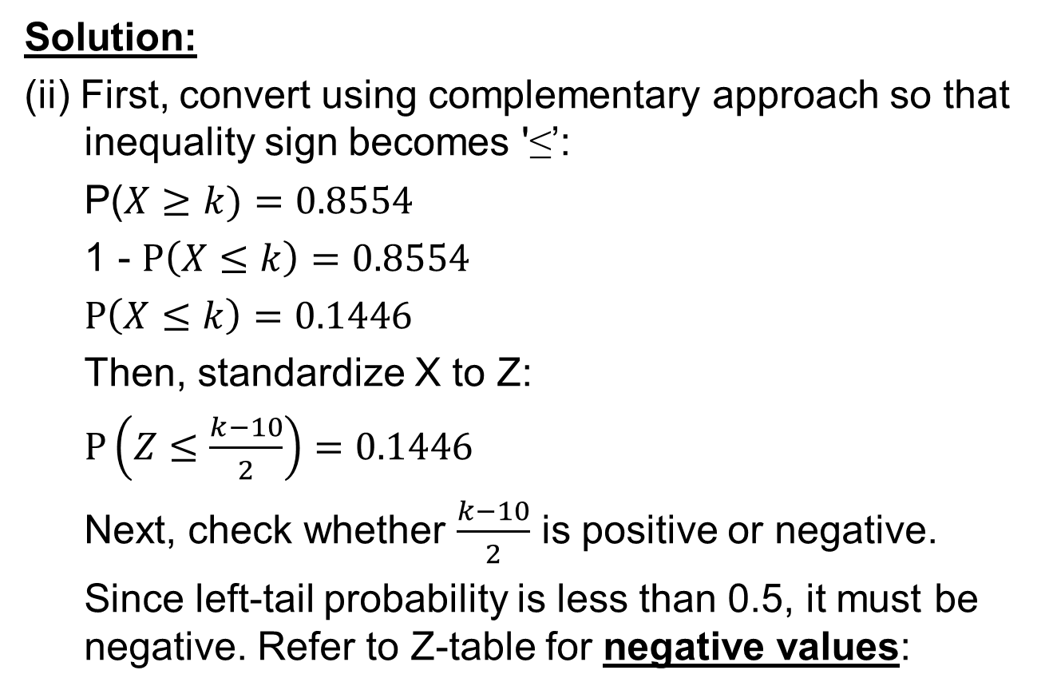
Using Standard Normal Distribution Tables to Calculate Inverse of Normal Distribution
Solution:
(ii) First, convert using complementary approach so that inequality sign becomes '≤’:
P($X≥k)=0.8554$
1 - $P\left(X≤k\right)=0.8554$
$P\left(X≤k\right)=0.1446$
Then, standardize X to Z:
$P\left(Z≤\frac{k−10}{2}\right)=0.1446$
Next, check whether $\frac{k−10}{2}$ is positive or negative.
Since left-tail probability is less than 0.5, it must be negative. Refer to Z-table for negative values:

Slide 14
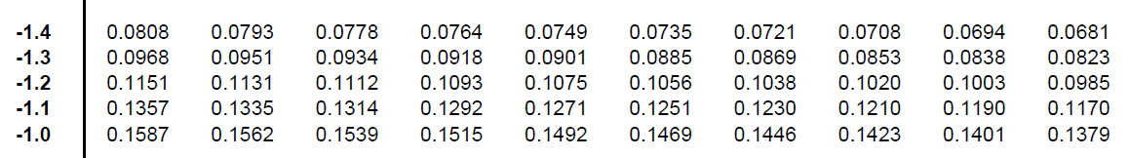

Using Standard Normal Distribution Tables to Calculate Inverse of Normal Distribution
Solution:
(ii)
Check the probability value to see if we can find 0.1446.
Working backwards, we can see that
$$\frac{k−10}{2}=−\left(1.0+0.06\right)=−1.06$$
$$k=7.88 ∎$$

Slide 15
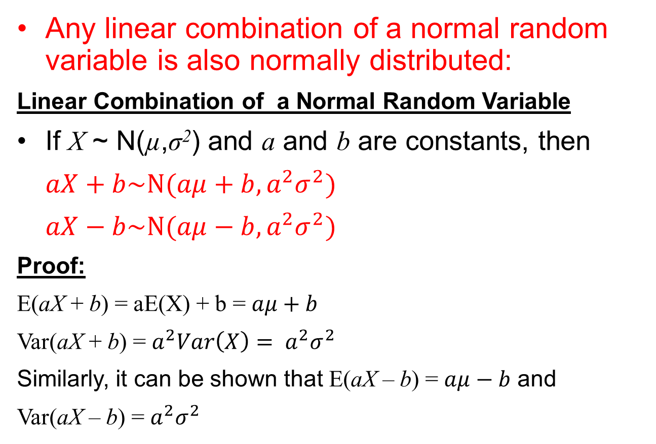
Linear Combination of Normal Random Variables
Any linear combination of a normal random variable is also normally distributed:
Linear Combination of a Normal Random Variable
If X ~ N(µ,σ²) and a and b are constants, then
$aX+b\sim N(aμ+b,a^{2}σ^{2})$
$aX−b\sim N(aμ−b,a^{2}σ^{2})$
Proof:
E(aX + b) = aE(X) + b = $aμ+b$
Var(aX + b) = $a^{2}Var\left(X\right)= a^{2}σ^{2}$
Similarly, it can be shown that E(aX – b) = $aμ−b$ and
Var(aX – b) = $a^{2}σ^{2}$

Slide 16
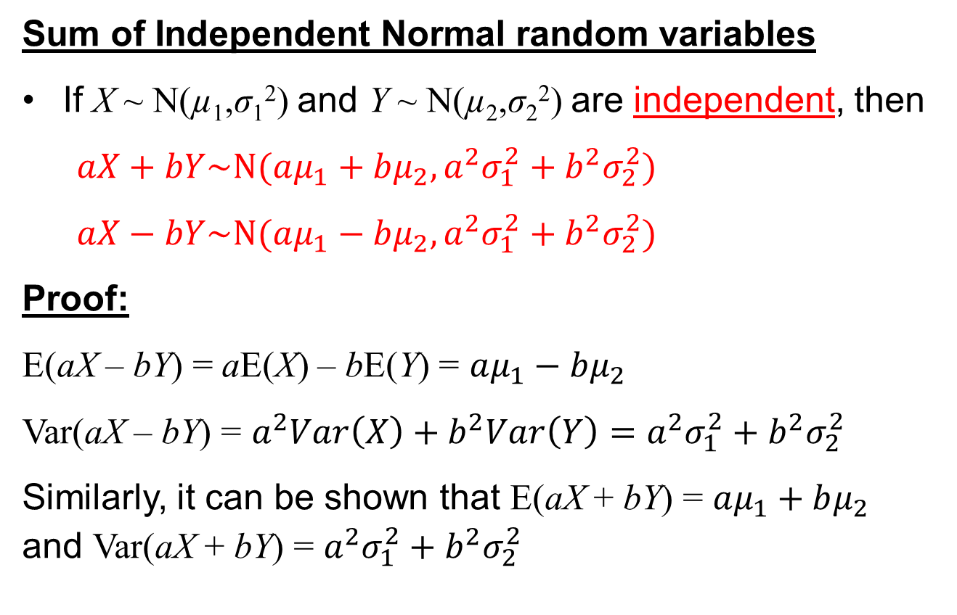
Linear Combination of Normal Random Variables
Sum of Independent Normal random variables
If X ~ N(µ₁,σ₁²) and Y ~ N(µ₂,σ₂²) are independent, then
$aX+bY\sim N(aμ_{1}+bμ_{2}, a^{2}σ_{1}^{2}+b^{2}σ_{2}^{2})$
$aX−bY\sim N(aμ_{1}−bμ_{2}, a^{2}σ_{1}^{2}+b^{2}σ_{2}^{2})$
Proof:
E(aX – bY) = aE(X) – bE(Y) = $aμ_{1}−bμ_{2}$
Var(aX – bY) = $a^{2}Var\left(X\right)+b^{2}Var\left(Y\right)=a^{2}σ_{1}^{2}+b^{2}σ_{2}^{2}$
Similarly, it can be shown that E(aX + bY) = $aμ_{1}+bμ_{2}$ and Var(aX + bY) = $a^{2}σ_{1}^{2}+b^{2}σ_{2}^{2}$
Note:
X and Y must be independent to apply this result!
Always “+”

Slide 17
Example - Linear Combination of Normal Random Variables
The time taken by Samuel to do his Mathematics assignments can be modelled using a normal distribution with a mean of 50 minutes and a standard deviation of 10 minutes.
The time (in minutes) taken by Janice also follows an independent normal distribution with a mean of 30 minutes and a standard deviation of 5 minutes.
Find the probability that, for a particular assignment, Samuel takes more than twice as long as Janice.

Slide 18
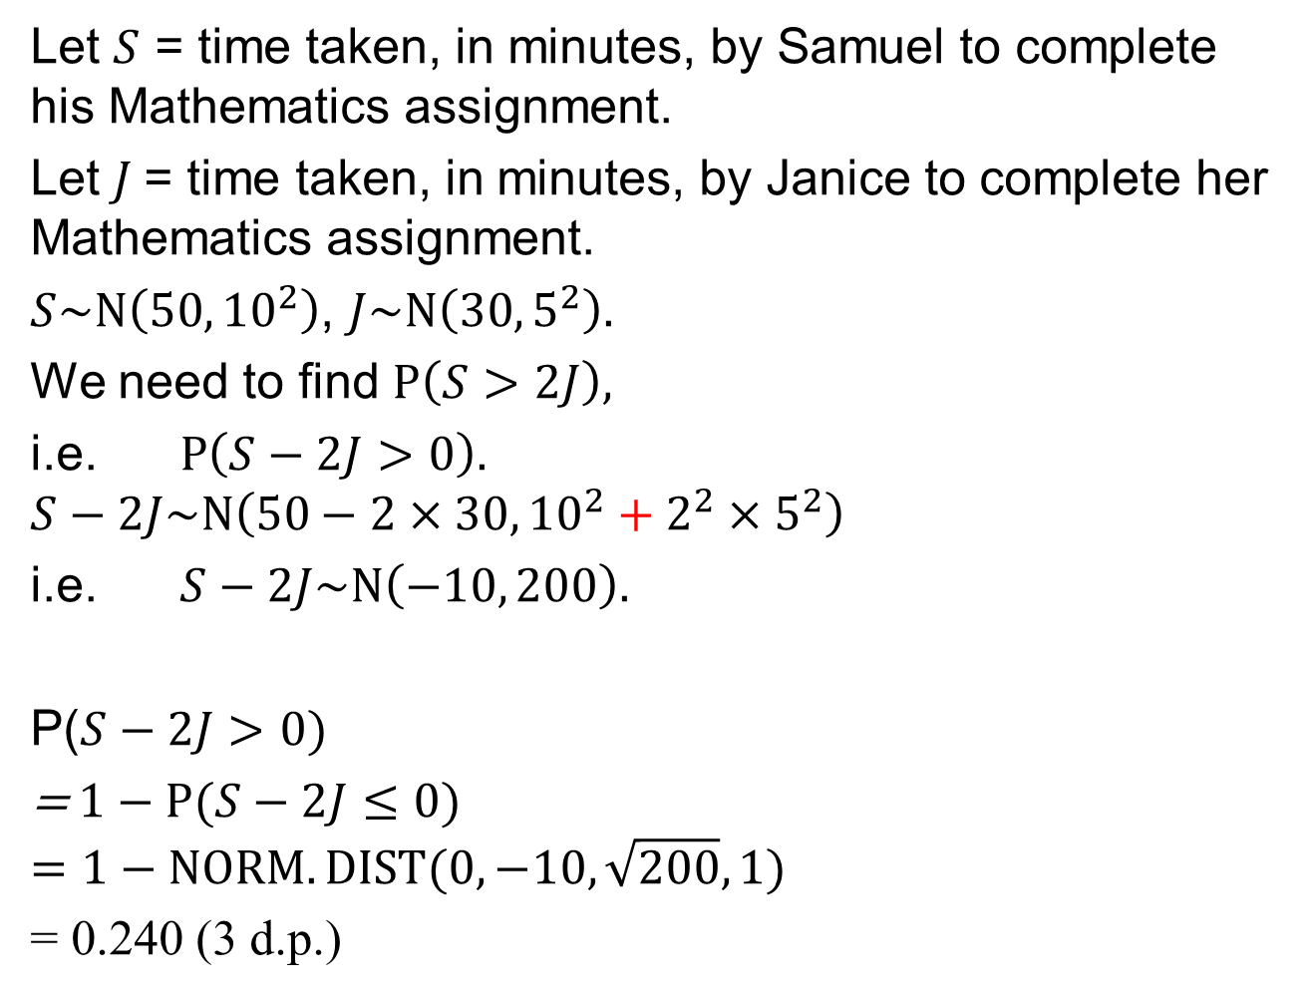
Solution- Linear Combinations of Normal Random Variables
Let $S$ = time taken, in minutes, by Samuel to complete his Mathematics assignment.
Let $J$= time taken, in minutes, by Janice to complete her Mathematics assignment.
$S\sim N\left(50, {10}^{2}\right)$, $J\sim N\left(30,5^{2}\right).$
We need to find $P\left(S>2J\right),$
i.e. $P\left(S−2J>0\right).$
$$S−2J\sim N\left(50−2×30,{10}^{2}+2^{2}×5^{2}\right)$$
i.e. $S−2J\sim N\left(−10, 200\right).$
P($S−2J>0)$
=$1−P(S−2J≤0)$
$$=1−NORM.DIST(0,−10,\sqrt{200},1)$$
= 0.240 (3 d.p.)
Follow this framework:
Define the normal random variable(s)
State the normal distribution(s).
Solve the problem.

Slide 19
Example – Linear Combination of Normal Random Variables
Students in their final year of college took a national statistics examination. The mean and standard deviation of students’ scores from School A and B are summarised in the table below. The distribution of scores from both schools are normal.
One student each are randomly selected from School A and School B. What is the chance that the student from School B has a higher score than the student from School A and the difference in score is more than 5?
School | Mean | Standard deviation
A | 62 | 8
B | 70 | 5

Slide 20
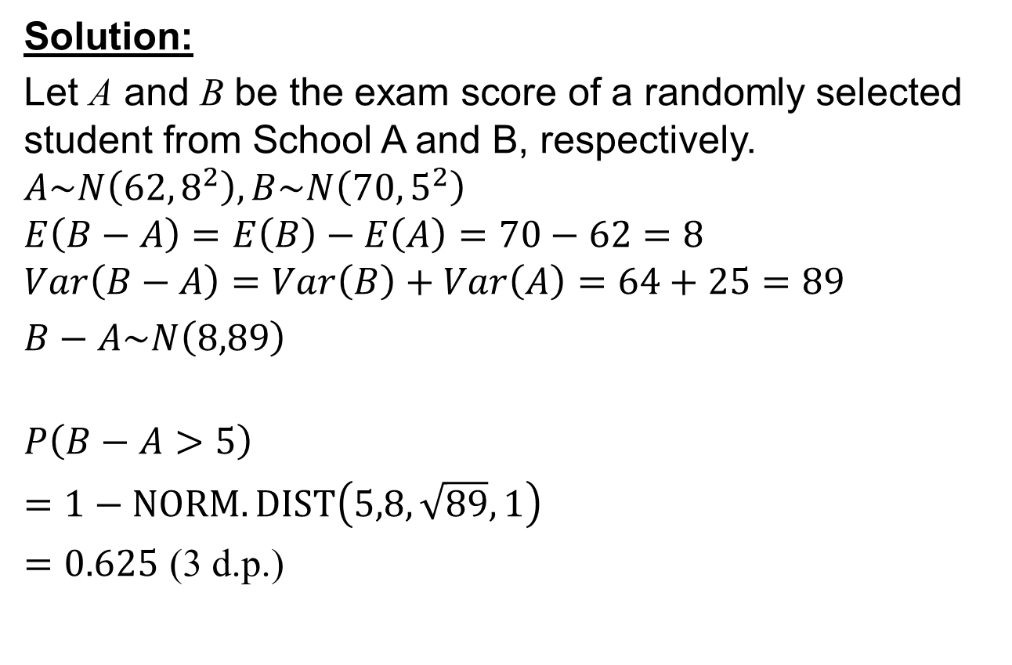
Example – Linear Combination of Normal Random Variables
Solution:
Let A and B be the exam score of a randomly selected student from School A and B, respectively.
$$A\sim N\left(62,8^{2}\right),B\sim N\left(70,5^{2}\right)$$
$$E\left(B−A\right)=E\left(B\right)−E\left(A\right)=70−62=8$$
$$Var\left(B−A\right)=Var\left(B\right)+Var\left(A\right)=64+25=89$$
$B−A\sim N\left(8,89\right)$
$$P\left(B−A>5\right)$$
$=1−NORM.DIST\left(5,8,\sqrt{89},1\right)$
$=0.625$ (3 d.p.)

Slide 21
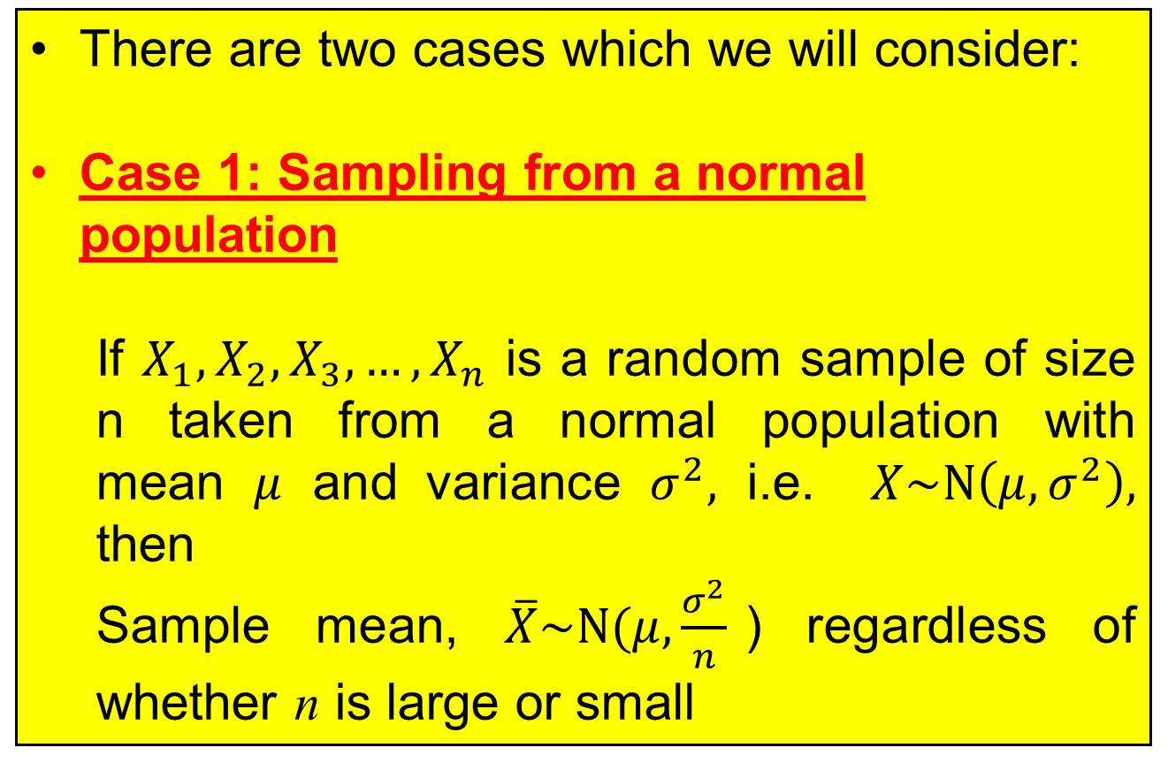
Sampling Distribution of Sample Means
There are two cases which we will consider:
Case 1: Sampling from a normal population
If $X_{1},X_{2},X_{3},…,X_{n}$ is a random sample of size n taken from a normal population with mean $μ$ and variance $σ^{2},$ i.e. $X\sim N\left(μ,σ^{2}\right),$ then
Sample mean, $\overline{X}\sim N(μ,\frac{σ^{2}}{n}$) regardless of whether n is large or small

Slide 22
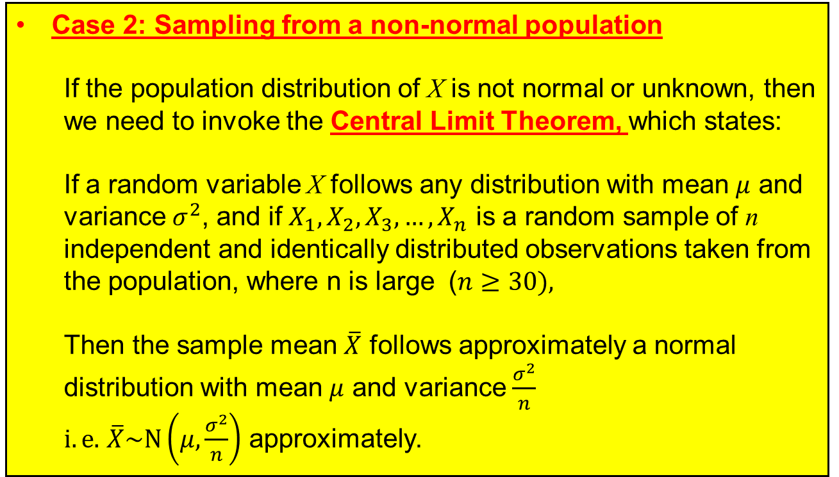
Sampling Distribution of Sample Means
Case 2: Sampling from a non-normal population
If the population distribution of X is not normal or unknown, then we need to invoke the Central Limit Theorem, which states:
If a random variable X follows any distribution with mean $μ$ and variance $σ^{2}$, and if $X_{1},X_{2},X_{3},…,X_{n}$ is a random sample of n independent and identically distributed observations taken from the population, where n is large ($n≥30),$
Then the sample mean $\overline{X}$ follows approximately a normal distribution with mean $μ$ and variance $\frac{σ^{2}}{n}$
$i.e.$ $\overline{X}\sim N\left(μ,\frac{σ^{2}}{n}\right)$ approximately.

Slide 23
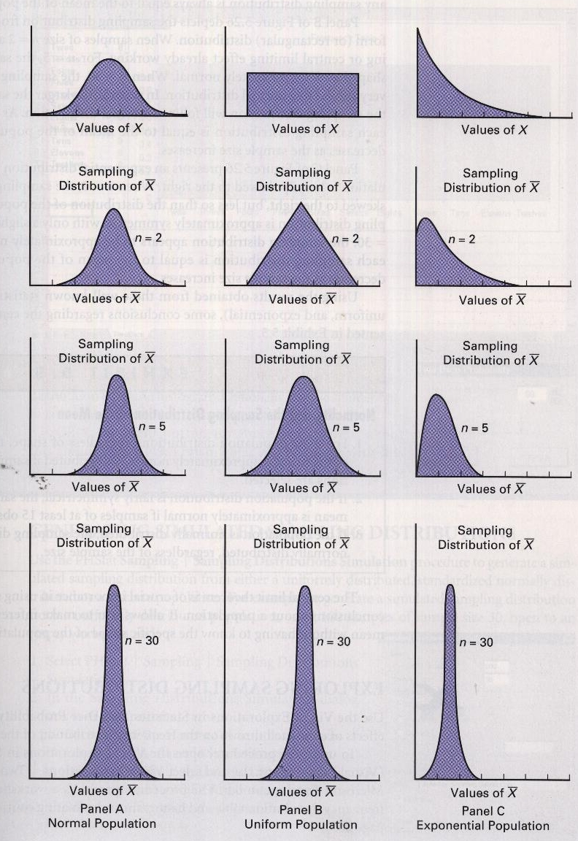
The Central Limit Theorem (CLT)
Normal
Uniform
Exponential
Population Distribution
Significance of CLT:
It permits us to use sample statistics to make inferences about the population parameters without knowing anything about the specific shape of the population distribution.
Sample of n=2
Sample of n=5
Sample of n=30
Try: http://www.chem.uoa.gr/applets/appletcentrallimit/appl_centrallimit2.html

Slide 24
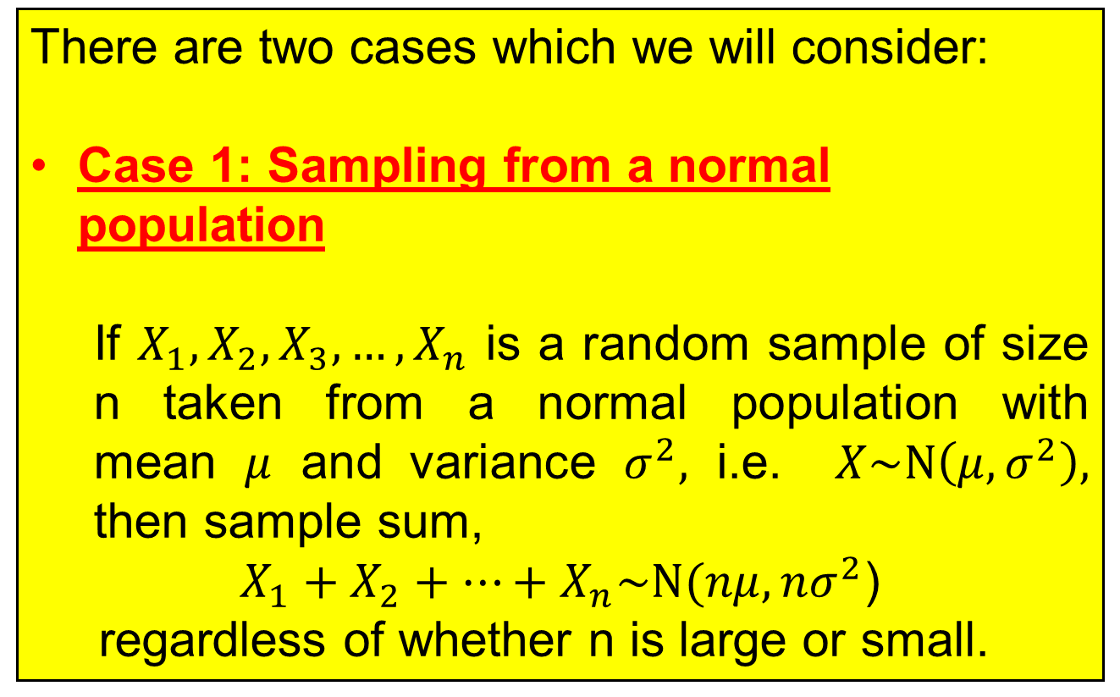
Sampling Distribution of the Sample Sum
There are two cases which we will consider:
Case 1: Sampling from a normal population
If $X_{1},X_{2},X_{3},…,X_{n}$ is a random sample of size n taken from a normal population with mean $μ$ and variance $σ^{2},$ i.e. $X\sim N\left(μ,σ^{2}\right),$ then sample sum,
$X_{1}+X_{2}+…+X_{n}\sim N(nμ,nσ^{2}$)
regardless of whether n is large or small.

Slide 25
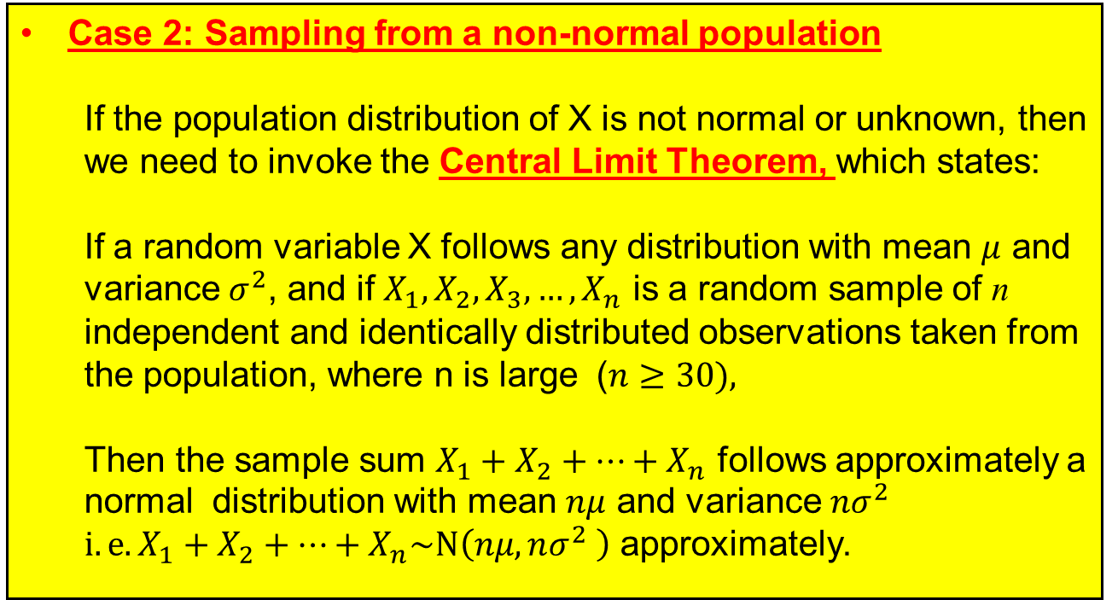
Sampling Distribution of the Sample Sum
Case 2: Sampling from a non-normal population
If the population distribution of X is not normal or unknown, then we need to invoke the Central Limit Theorem, which states:
If a random variable X follows any distribution with mean $μ$ and variance $σ^{2}$, and if $X_{1},X_{2},X_{3},…,X_{n}$ is a random sample of n independent and identically distributed observations taken from the population, where n is large ($n≥30),$
Then the sample sum $X_{1}+X_{2}+…+X_{n}$ follows approximately a normal distribution with mean $nμ$ and variance $nσ^{2}$
$i.e.X_{1}+X_{2}+…+X_{n}\sim N\left(nμ,nσ^{2} \right)$ approximately.

Slide 26
Learning Objectives
Define a normal random variable
State and apply the characteristics and properties of a normal distribution curve
Apply the normal distribution model to calculate probabilities
Determine the standardization process for a given normal distribution
Apply the concept of a sampling distribution of the sample means and the sample sum
Apply the Central Limit Theorem for large sample sizes to determine the sampling distributions of the sample means, the sample sum and calculate probabilities

Slide 27
E-Learning Video
You are strongly encouraged to watch the e-learning video prepared for L07 to enhance your understanding of the main learning objectives.
You can access the e-learning video from the following link:
https://drive.google.com/file/d/0B0VVo-P5cYtqRzQ1NHI5UGt3Q0E/edit?usp=sharing

